Slide 1
ER Diagram
Ref: Whitten et all, Systems Analysis and Design Methods 7e. McGraw-Hill Higher Education
Mostafijur Rahman Akhond
Lecture, CSE
BRAC University

Slide 2
INTRODUCTION
In this chapter, we discuss how the data are organized and presented.
A data model is a formal way of representing the data that are used and created by a business system.
During analysis (this Chapter), analysts draw a Logical data model which shows the logical organization of data without indicating how it is stored, created, or manipulated.

Slide 3
Entity-relationship Diagram (ERD)
An entity-relationship diagram (ERD) is a picture showing the information that is created, stored, and used by a business system.
Entities lists similar kinds of information.
Lines drawn between entities represent relationships among the data.
Special symbols communicate high-level business rules.

Slide 4
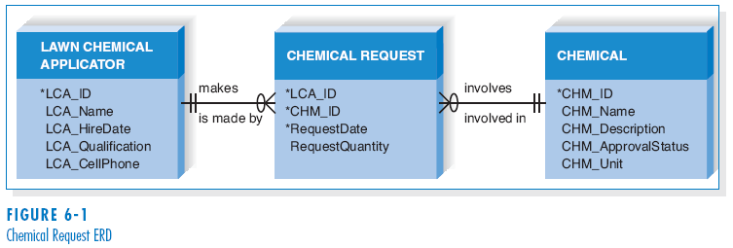
Reading an ER-Diagram

Slide 5
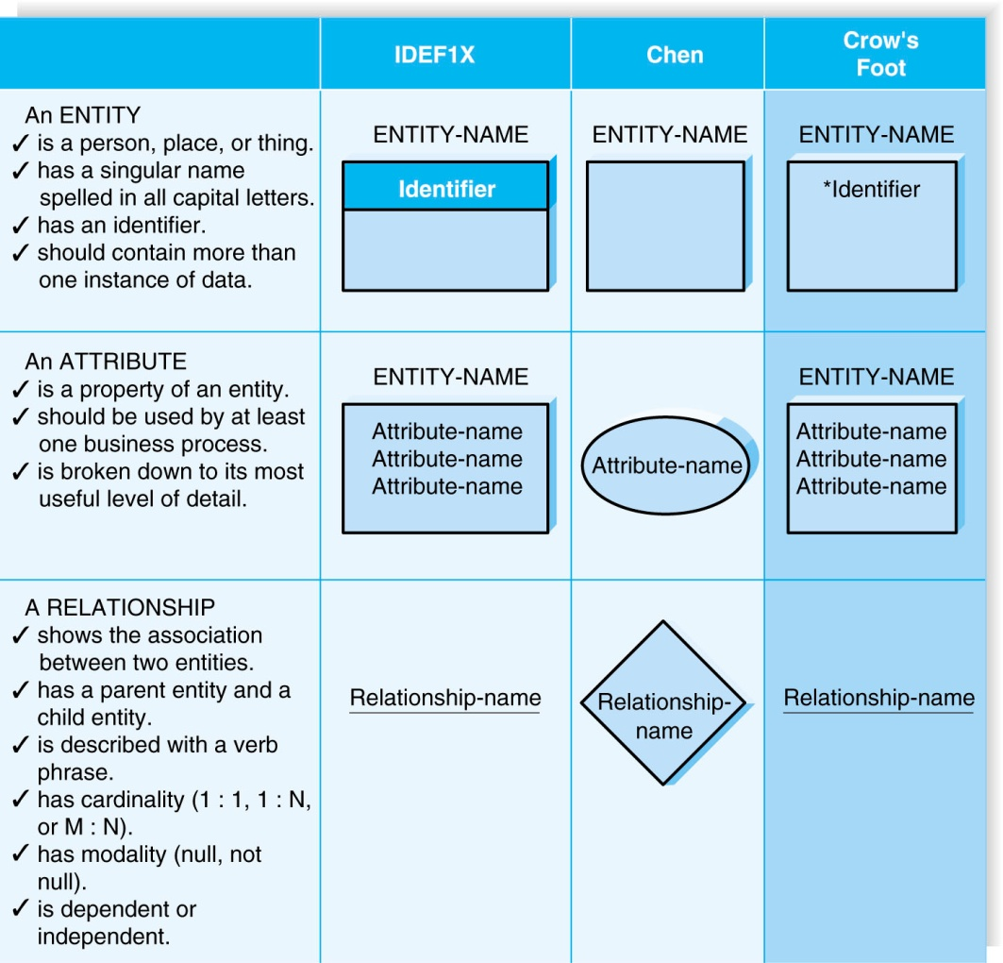
Elements of ERD

Slide 6
Entity
The entity is the basic building block for a data model. It is a person, place, event, or thing about which data is collected.
Entities represent something for which there exist multiple instances, or occurrences.
- E.g., John Smith could be an instance of the customer entity.

Slide 7
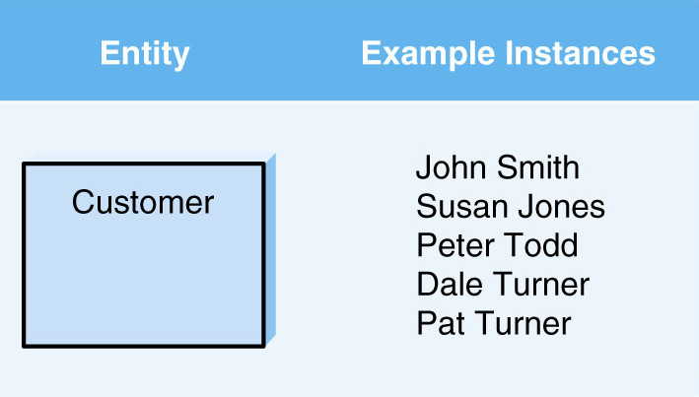
Entity (cont’d)

Slide 8
Attributes
An attribute is some type of information that is captured about an entity.
Attributes are nouns that are listed with an entity.
One or more attributes can serve as the entity identifier - the attribute(s) that can uniquely identify one instance of an entity.
Concatenated identifier - several attributes are combined to uniquely identify an instance.

Slide 9
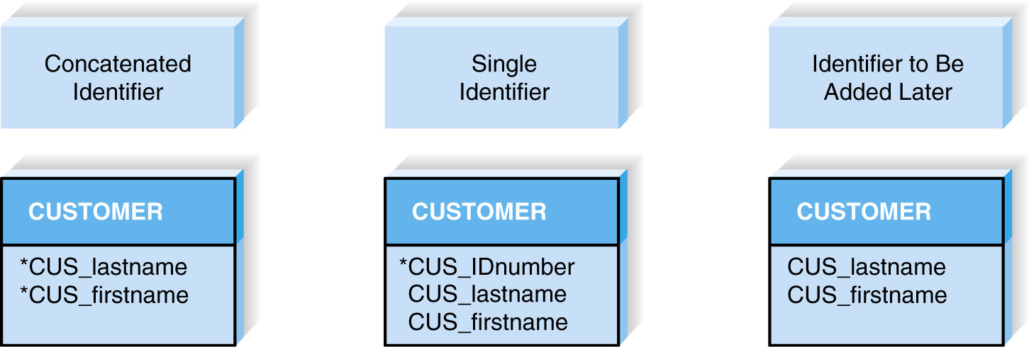
Attributes (cont’d)
Choices for Identifiers

Slide 10
Relationships
Relationships are associations between entities.
Every relationship has a parent entity and a child entity.
Relationships should be labeled with active verbs.

Slide 11
Cardinality
A relationship has cardinality which is the ratio of parent instances to child instances.
The 1:1 relationship means that one instance of the parent entity is associated with one instance of the child entity.
The 1:N relationship means that a single instance of a parent entity is associated with many instances of a child entity.
The M:N relationship means that many instances of a parent entity can relate to many instances of a child entity.

Slide 12
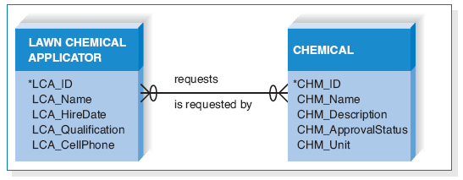
Cardinality (cont’d)
Example of M:N Relationship

Slide 13
Modality
A relationship has modality of null or not null, which refers to whether or not an instance of a child entity can exist without a related instance in the parent entity.
Null means that an instance of a child entity can exist without a related instance in the parent entity.
Not Null means that an instance of a child entity can’t exist without a related instance in the parent entity.

Slide 14
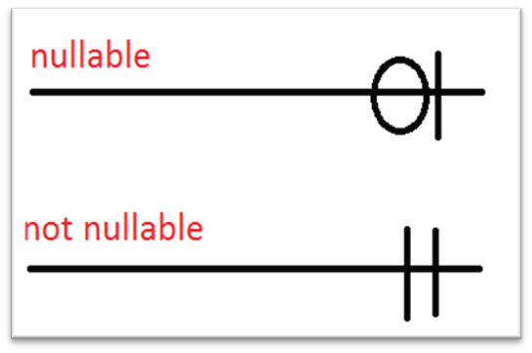
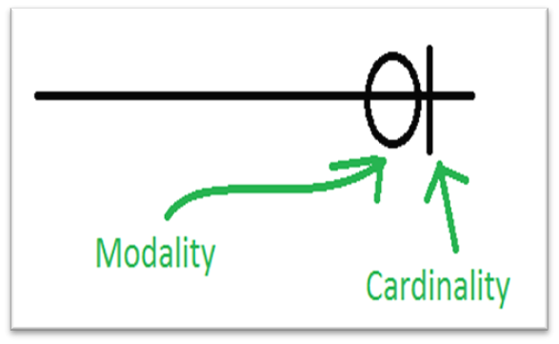
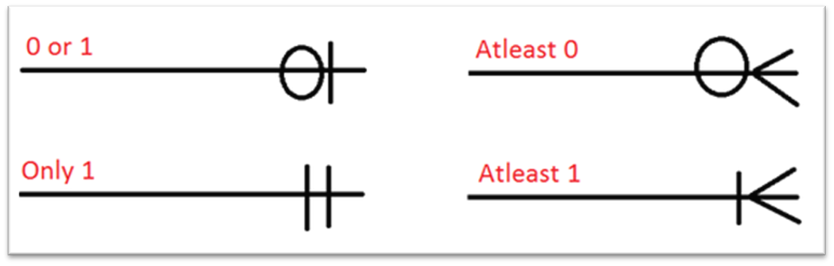
Modality (cont’d)
Cardinality and modality together gives us four possible combinations:

Slide 15
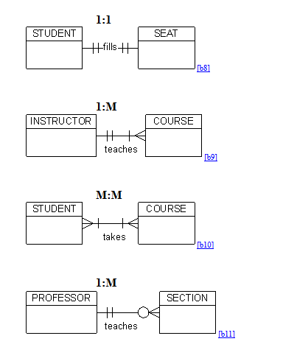
Example Relations

Slide 16
Data dictionary
A data dictionary is a collection of descriptions of the data objects or items in a data model for the benefit of programmers and others who need to refer to them.
Identify each object and its relationship to other objects. This process is called data modeling.
  given a descriptive name
  its relationship is described
  possible predefined values are listed,
  a brief textual description is provided.
This collection can be organized for reference into a book called a data dictionary.

Slide 17
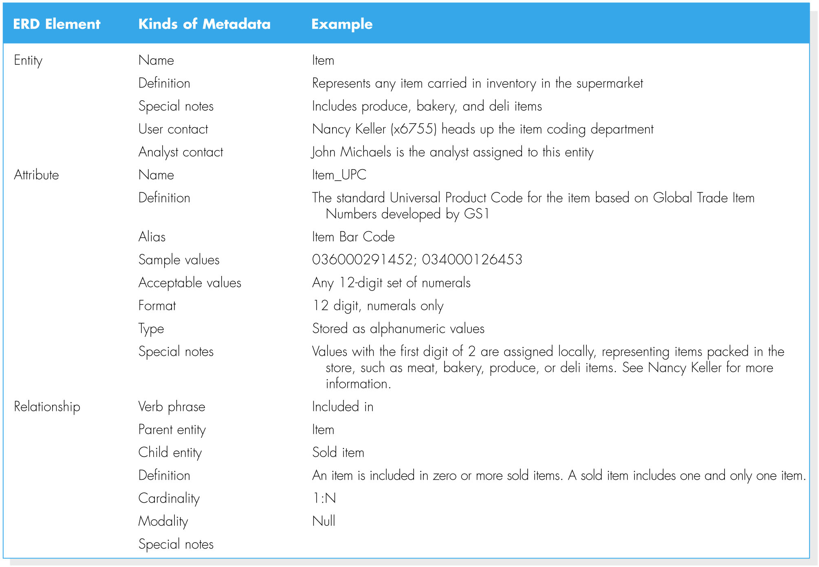
Types of Metadata Captured by the Data Dictionary

Slide 18
Creating an ERD
Drawing the ERD is an iterative process of trial and revision.
The basic steps in building an ERD:
  1. Identify the entities;
  2. add the appropriate attributes to each entity;
  3. draw relationships among entities.

Slide 19
Step 1: Identify the Entities
The entities should represent the major categories of information that you need to store in your system.
If you begin the data model using a use case, look at the major inputs and outputs of the use case.
If the process models are available, look at the data stores, external entities, and data flows.

Slide 20
Step 2: Add Attributes and Assign Identifiers
The information that describes each entity becomes its attributes.
  Check in the CASE repository of the process model for details on data flows and data stores.
  Check the data requirements of the requirements definition.
  Use requirements elicitation techniques (e.g., interview and document analysis).
One or more of the attributes will become the entity’s identifier.

Slide 21
Step3: Identify Relationships
The last step in creating ERDs is to determine how the entities are related to each other.
Lines are drawn between the entities that have relationships.
Each relationship is labeled, and cardinality and modality are assigned.

Slide 22
Advanced Syntax
Three special types of entities:
  Independent Entity
  Dependent Entity
  Intersection Entity

Slide 23
Independent Entity
Can exist without the help of another entity.
The identifiers is created from the entity’s own attributes.
Attributes from other entities are not needed to uniquely identify instances of these entities.

Slide 24
Dependent Entity
There are situations when a child entity does require attributes from the parent entity to uniquely identify an instance.
In these cases, the child entity is called a dependent entity, and its identifier consists of at least one attributes from the parent entity.

Slide 25
Intersection Entity
It exists in order to capture some information about the relationship between two other entities.
Typically, intersection entities are added to a data model to store information about two entities sharing an M : N relationship.

Slide 26
Intersection Entity(cont’d)
There are three steps involved in adding an intersection entity:
Step 1. Remove the M:N relationship line and insert a new entity (intersection entity) in between the two existing ones.
Step 2. Add two 1:N relationships to the model.
Step 3. Name the intersection entity.

Slide 27
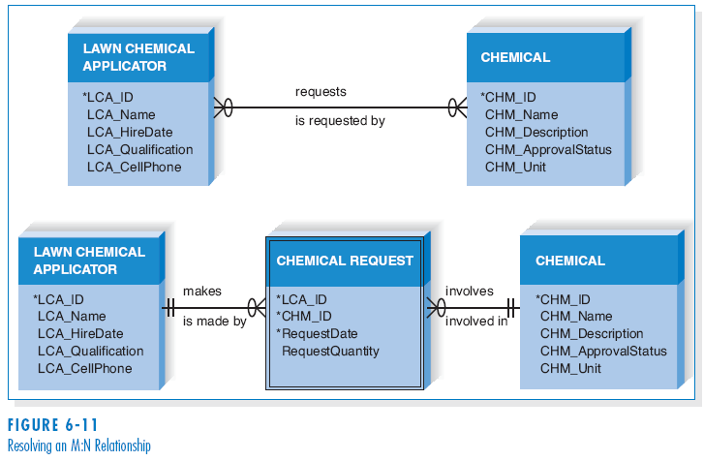
Intersection Entity (cont’d)

Slide 28
Validating an ERD
General design guidelines.
Normalization.
Check the ERD against the process models to make sure that both model balance each other.

Slide 29
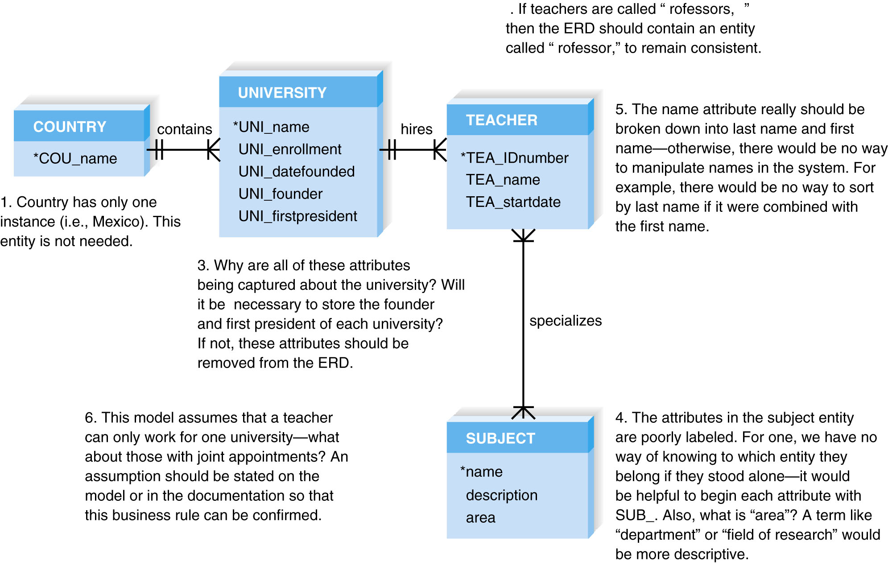
Design Guidelines

Slide 30
Normalization
Normalization is a technique that can help analysts validate the data models.
It is a process whereby a series of rules are applied to a logical data model to determine how well formed it is.

Slide 31
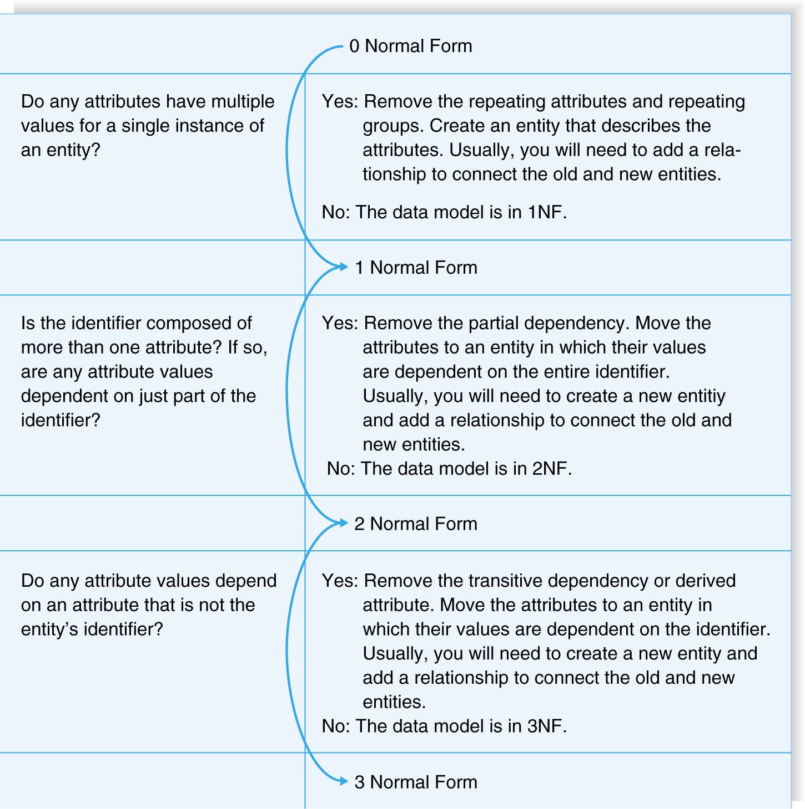
Normalization Steps

Slide 32
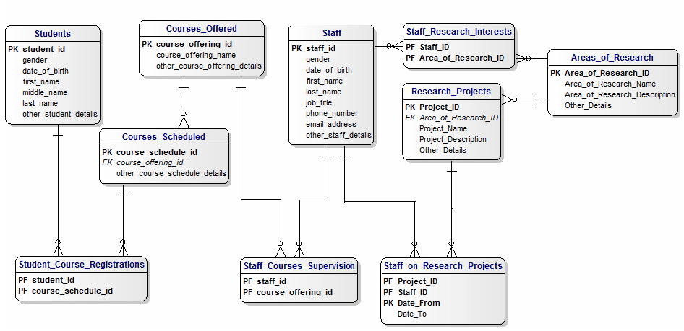
Sample ER diagram of University Management System

Slide 33
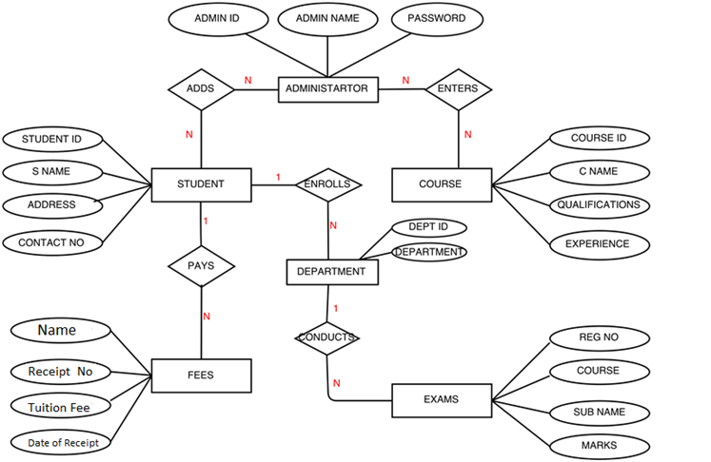
Student Management system

Slide 34
SUMMARY
Basic Entity Relationship Diagram Syntax
  - Entity describes people, places, or things.
  - Attribute is some type of information about the entity.
  - Relationship conveys the associations between entities.
Creating an ERD
- Identify the entities.
- Add the attributes to each entity.
- Draw relationships among entities.
Validating an ERD
- Normalization

